Slide 1


Bank Loan Case Study

Slide 2


TASK
A. Identify Missing Data and Deal with it Appropriately: As a data analyst, you come across missing data in the loan application dataset. It is essential to handle missing data effectively to ensure the accuracy of the analysis.
Task: Identify the missing data in the dataset and decide on an appropriate method to deal with it using Excel built-in functions and features.
B. Identify Outliers in the Dataset: Outliers can significantly impact the analysis and distort the results. You need to identify outliers in the loan application dataset.
Task: Detect and identify outliers in the dataset using Excel statistical functions and features, focusing on numerical variables.
C. Analyze Data Imbalance: Data imbalance can affect the accuracy of the analysis, especially for binary classification
problems. Understanding the data distribution is crucial for building reliable models.
Task: Determine if there is data imbalance in the loan application dataset and calculate the ratio of data imbalance
using Excel functions.
D. Perform Univariate, Segmented Univariate, and Bivariate Analysis: To gain insights into the driving factors of
loan default, it is important to conduct various analyses on consumer and loan attributes.
Task: Perform univariate analysis to understand the distribution of individual variables, segmented univariate analysis to compare variable distributions for different scenarios, and bivariate analysis to explore relationships between variables and the target variable using Excel functions and features.
E. Identify Top Correlations for Different Scenarios: Understanding the correlation between variables and the target variable can provide insights into strong indicators of loan default.
Task: Segment the dataset based on different scenarios (e.g., clients with payment difficulties and all other cases) and identify the top correlations for each segmented data using Excel functions.

Slide 3
Analytics Tasks

Slide 4






Analytics Tasks

Slide 5
Identify Missing Data

Slide 6
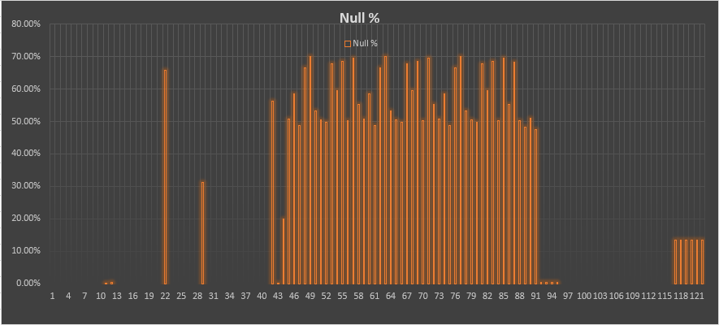
Identify Missing Data
and Deal with it Appropriately
Before total columns: 122
Removed coulmns those having null%=>40%
After Removing : 76
122-76=46 coulmns Removed

Slide 7
Identify Outliers

Slide 8
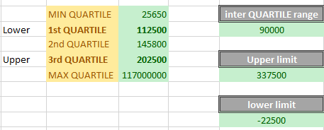
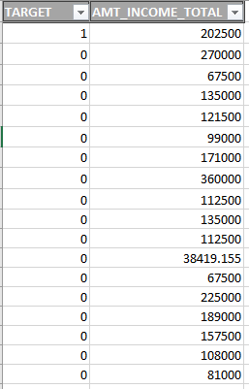
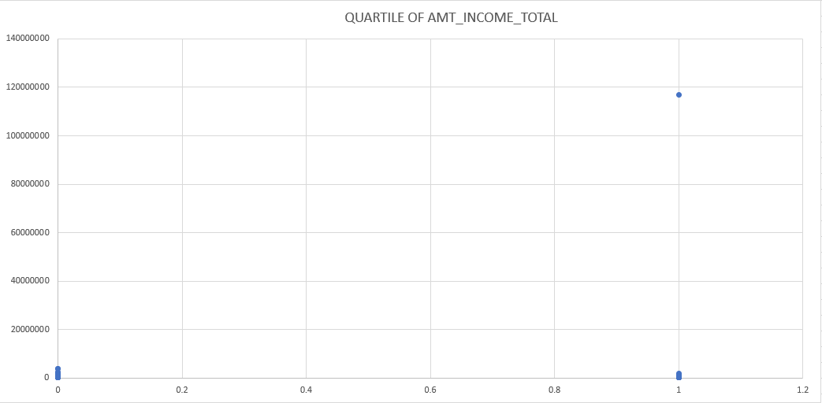
Identify Outliers
in the Dataset
1st QUARTILE : =QUARTILE.INC(I:I,1)
3rd QUARTILE : =QUARTILE.INC(I:I,3)
Inter QUARTILE range: 3rd -1st QUARTILE
Upper limit : 3rd + (1.5 x inter qua. )
lower limit : 1st - (1.5 x inter qua. )

Slide 9
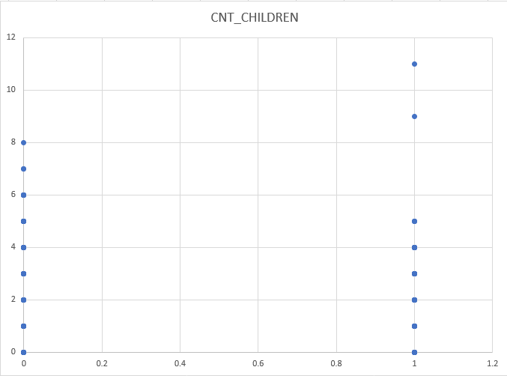
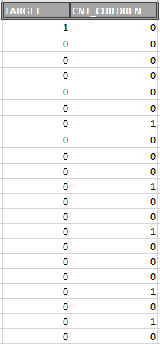

Slide 10
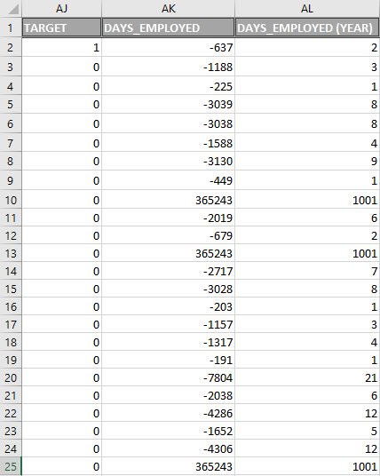
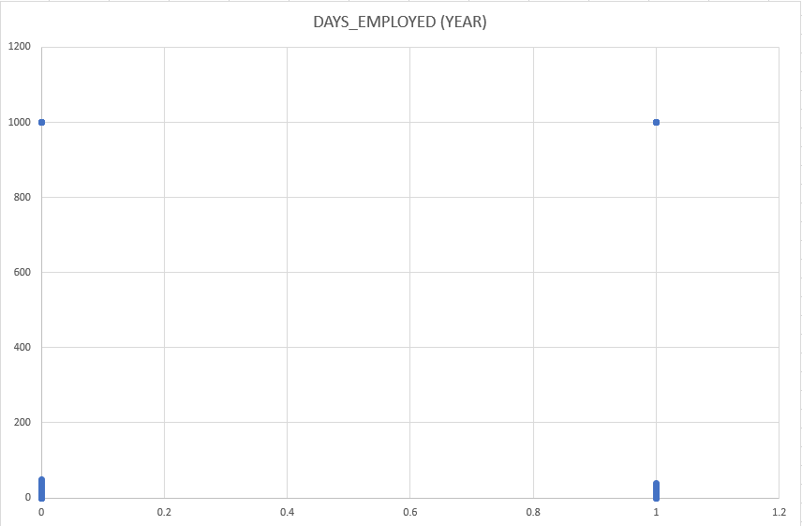
Convert days into year: =ABS(AK2/365) {so -637 days = 2Year}

Slide 11
Data Imbalance

Slide 12
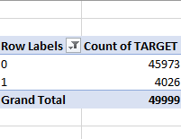
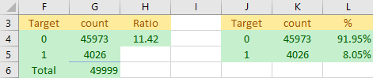
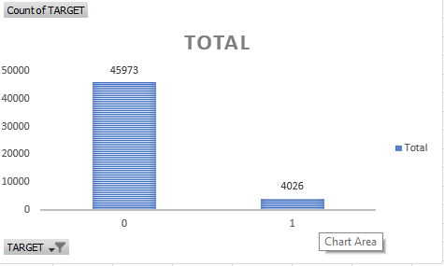
Analyze
Data Imbalance
Ratio : G4/G5=11.42
Percentage :Target0: 91.95%
Target1: 8.05%

Slide 13
Perform Univariate

Slide 14
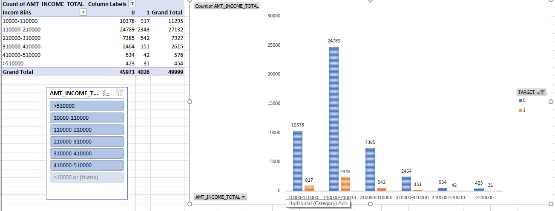
Perform Univariate
, Segmented Univariate, and Bivariate Analysis
Segmented Univariate

Slide 15
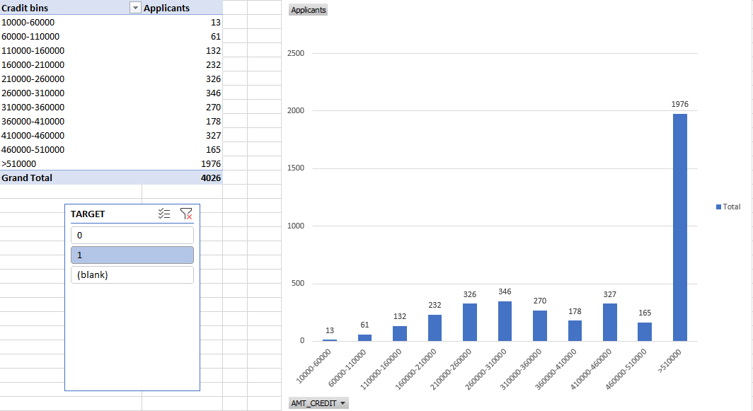
Univariate

Slide 16
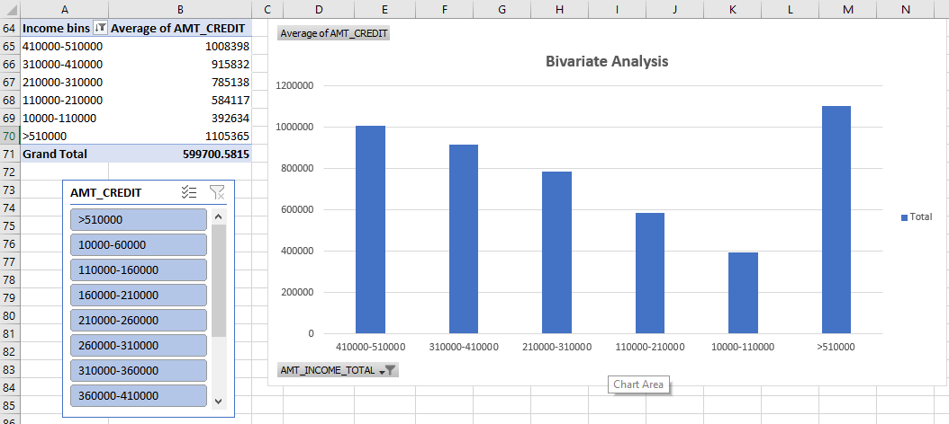
Bivariate Analysis

Slide 17
Top Correlations

Slide 18
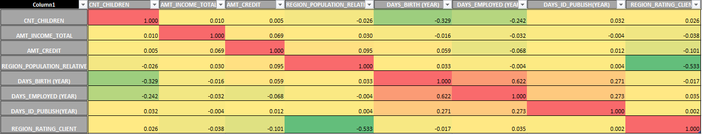
Top Correlations
for Different Scenarios
Identify

Slide 19
Conclusion
Project Description: The primary goal is to identify patterns indicating if a customer will struggle to pay their installments. This insight can inform decisions like denying loans, reducing loan amounts, or adjusting interest rates for risky applicants. The company aims to comprehend key factors behind loan defaults to enhance loan approval decisions.
Approach
A. Identify Missing Data and Deal with it Appropriately:
Identify Missing Data:Use Excel functions like COUNT, ISBLANK, and IF to spot missing data.
Deal with Missing Data:Employ Excel functions like AVERAGE or MEDIAN for imputation.
B. Identify Outliers in the Dataset:
Detect Outliers:Utilize Excel statistical functions like QUARTILE and IQR to flag potential outliers.
C. Analyze Data Imbalance:
Determine Data Imbalance:Utilize Excel functions like COUNTIF and SUM to compute class proportions.
D. Perform Univariate, Segmented Univariate, and Bivariate Analysis:
Univariate Analysis:Use Excel functions like COUNT, AVERAGE, and MEDIAN for descriptive analysis.
Segmented Univariate Analysis:Utilize Excel features such as filters, sorting, and pivot tables for comparative analysis.
Bivariate Analysis:Explore variable relationships with the target using Excel functions and features.
E. Identify Top Correlations for Different Scenarios: Segment the dataset based on scenarios (e.g., customers with payment difficulties and others).
Tech-Stack Used: Microsoft Excel 2022
Insights:
Missing Data Handling: Identified missing data across various variables in the dataset.
Outlier Detection: Detected outliers in numerical variables using statistical methods like interquartile range (IQR).
Data Imbalance Analysis: Determined the presence of data imbalance within the target variable.
Univariate Analysis: Conducted univariate analysis to understand the distribution of individual variables.
Segmented Univariate Analysis: Compared variable distributions across different scenarios, such as customers with payment difficulties and others.
Bivariate Analysis: Explored relationships between variables and the target variable (loan default).
Correlation Analysis: Segmenting the dataset based on scenarios, identified top correlations with the target variable within each segment.
Decision Support: The insights gained from EDA can support various decision-making processes within the finance company.
Continuous Improvement: EDA is an iterative process, and further analysis may be needed as new data becomes available or business objectives evolve.
Result:
Our analysis began by addressing data quality issues, including missing values and outliers, ensuring the integrity and reliability of our findings. We then proceeded to explore the distribution of individual variables, identify patterns across different scenarios, and examine relationships between variables and loan default.

Slide 20
THANK YOU
SURAJ KUMAR
Cocsamcoc69@gmail.com

